Slide 1
HARTING AutoID in Production & Logistics HAIPL presentation MAKC 28.08.2013 - Moscow

Slide 2
HARTING the company

Slide 3
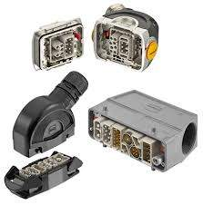
HARTING
founded: 1945
based in Espelkamp, Germany
100 % in private ownership of the Harting family
turnover in 2011/2012: € 479 million
ca. 3.600 employees worldwide
11 locations for production
8 development centers
Inhalt

Slide 4
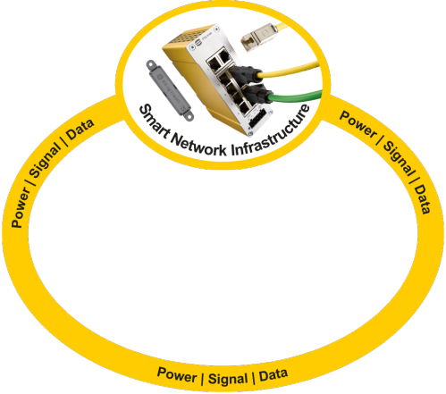
connectivity & networks & solutions
network & RFID components (Ha-VIS) for infrastructure solutions
connectors & installation concepts (Han®) in an industrial infrastructure
device connectivity (har-) for infrastructure devices
Inhalt

Slide 5
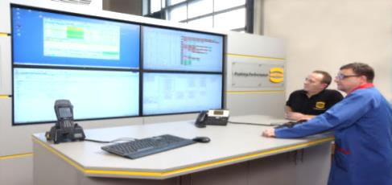
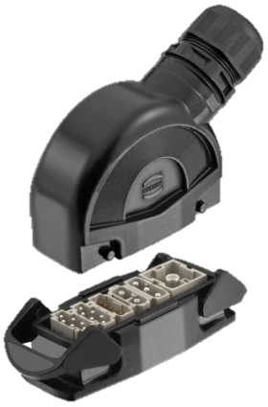
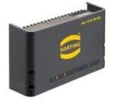
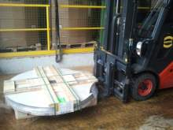
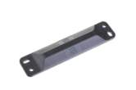
Integrated Industry „triple strategy“
Integrated Industry
System Solutions + Consulting
System Solutions + Consulting
Application Solutions + Services
Application Solutions + Services
HARTING IT System Integration: Integrated Industry
Innovative Components
Innovative Components
support & optimize industrial processes
products & system integration
digital „enrichment“ of products with Auto-ID

Slide 6
Hardware Transponder & Reader

Slide 7
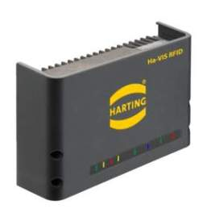
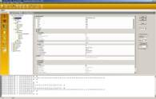
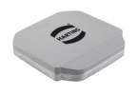
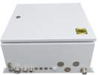
complete portfolio of RFID system components – part of HARTING product line
RFID-
transponder
antennas
cables
antenna
assembly-kit
reader with
assembly kit
connector protection
configuration tools, Demo-software, solutions

Slide 8
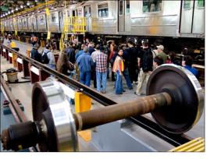
Ha-VIS RFID Transponder
UHF-Transponder –
focus on rough environmental conditions!
provide tags for industrial use
transportation (rail & aviation),
logistic applications
machinery/ automation
energy
use a variety of chip-manufacturers (NXP, Tego, Alien…) to provide
permanent-tags
hard-tags for rough & extreme conditions
long life-cycle
own antenna patents
specific technology for 3D- metallized plastic parts for antennas
smartlabels are not our business

Slide 9
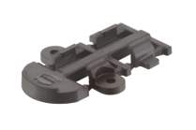
Ha-VIS RFID Transponder
Aviation project with LTL results in Ha-VIS RFID PT 86 and VT 89
Together with Lufthansa Technik and Logistics (LTL) we developed an tag for aviation usage in MRO-Processes (Maintenance, Repair, and Overhaul).
Memory 512 Bit
full certification according to RTCA DO 160
Various mounting possibilities
MID plastic housing (3D antenna)

Slide 10
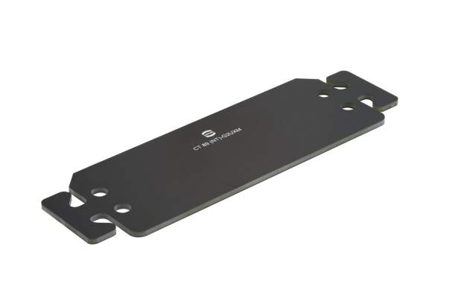
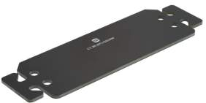
Ha-VIS RFID Transponder
Ha-VIS RFID CT 89, CF 89, CS 89 Transponder for wet surfaces and concrete
Another challenging ambience for RFID Transponder is concrete. With our CT89 we can reach many useful applications in building industries.
Advantages
Size 165 x 51 x 2 mm
Read Range 5 m
Extended memory
Temperature range of –40°C up to 85°C
Degree of protection up to IP69k
construction industrie
concrete applications
Concrete floor
Location from Storage Areas
reinforced
concrete applications

Slide 11
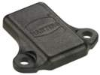
Ha-VIS RFID Transponder
Ha-VIS RFID SL 89 for special applications integrated in metallic ambience
RFID is always a problem to integrate in metallic ambience. This is caused by the shielding effect of metal. The SL89 is developed to overcome exactly this barrier by using the shielding metal as antenna.
Size 30 x 26 x 5 mm
Read Range 5 m
Function in metal
Temperature range of –40°C up to 85°C
Degree of protection up to IP69k
Extended memory
Steel-container
Beer-Barrel
Iron pipe
In metal
Railway
Set of wheels

Slide 12
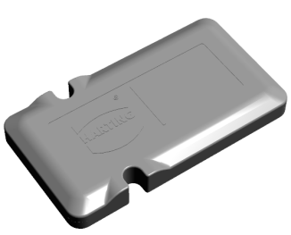
Ha-VIS RFID Transponder
Ha-VIS RFID XT 86, XT 89 – aviation transponder design
actual design and development of a suitable housing on customer requirements
compliant to all aviation standard requirements.
ATA Spec 2000, DO-160, SAE 5678
small, light, easy mounting
antenna for the maximum read range on metal.
parallel to development internal testing on requirements
testing and certification in cooperation with Gosniias

Slide 13
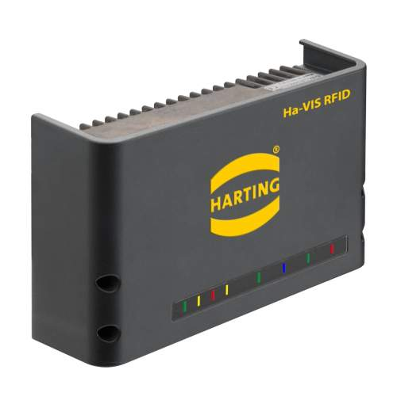
HARTING stationary RFID Reader Ha-VIS RF-R500
applicable in rough, metal-containing industrial environments
robust aluminum housing
IP53 / IP64 with optional protection cap
temperature: -25°C to +50°C
up to 4 antenna
high performance
high flexibility
GPIOs (5 in, 5 out)
approved for use in Russia

Slide 14
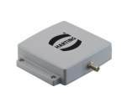
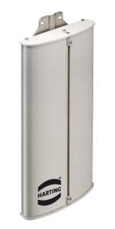
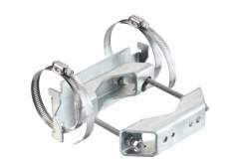
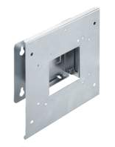
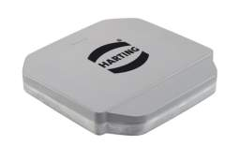
RFID antenna & accessories
Power supplies
Antenna from near field (from a few cm to over 10 m)
Antenna cable and adapter
Antenna mounting kits
IP65 / IP67

Slide 15
Solutions

Slide 16
General Goals I
create effective Auto-ID-solutions
use barcode or RFID-tags or both or something else for Auto-ID - don’t care for technology – care for process -
EPC-GS1 ALE 1.1 middleware (under GS1-certification) for stationary or simple mobile RFID-data collection
mobile integration - “full online” OR “full offline” OR “mixed scenarios” -
use standardized ID‘s (GS1) for tracking & tracing in process
Title of the chapter

Slide 17
General Goals II
Business Application Framework (BAF) → provide a toolbox to create solutions
Service-Oriented Architecture (SOA)
Enterprise-Service bus for simple connectivity
connection to standard backends (ERP, MES…) for large corporations
standalone solutions for small companies
process-oriented structuring to handle specific requirements, but also to effectively re-use modules
workflow based functionality for user processes
Title of the chapter

Slide 18
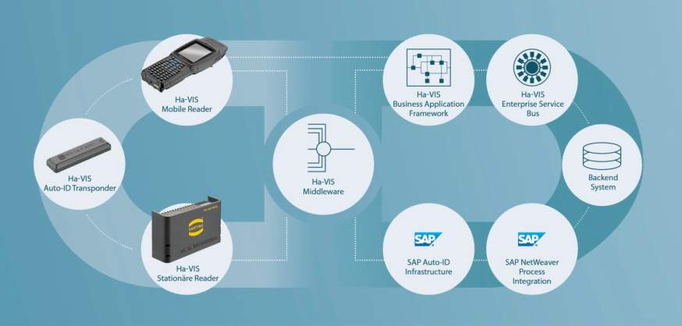
Integrated Auto-ID Solutions
Consulting
Concept
Hardware Software
Implementation
Service

Slide 19
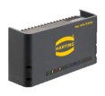
Ha-VIS Middleware ALE 1.1
→ implements GS1 standard Application Level Events (ALE) 1.1 (read&write)
realized as Middleware to connect to a variety of readers and subscribers
under certification by GS1
Ha-VIS Middleware
Connector
Subscriber
Middleware Management (GUI)

Slide 20
chances for Auto-ID in aviation processes
on-board processes
aircraft configuration management
periodic checks for completenes and expiration
maintenance processes
part identification while installed
simplifying handling & documentation
logistic processes
accelarated receiving/shipping at delivery points
proactive notification of needed/upcoming parts
process standardization
simplification of quality & certificate checks
prevent bogus parts
assisting in & promoting of paperless processes in connection with better user identification
liquidation of media breaks
part marking
standardization
data exchange

Slide 21
HARTING Auto-ID-solutions
Consulting
process consulting
ROI-identification
basic concept
Concept
detail concept
concept for integration in existing processes and system architecture
(technical) Proof-of-Concept
Hardware
Software
Reader, transponder & accessories
Ha-VIS Middleware, BAF
Business Templates (like eKanban)
Implementation
individual development
installation, configuration & integration
training
Service
keep software up-to-date
support (1st & 2nd Level)
Application Management

Slide 22
customer projects

Slide 23
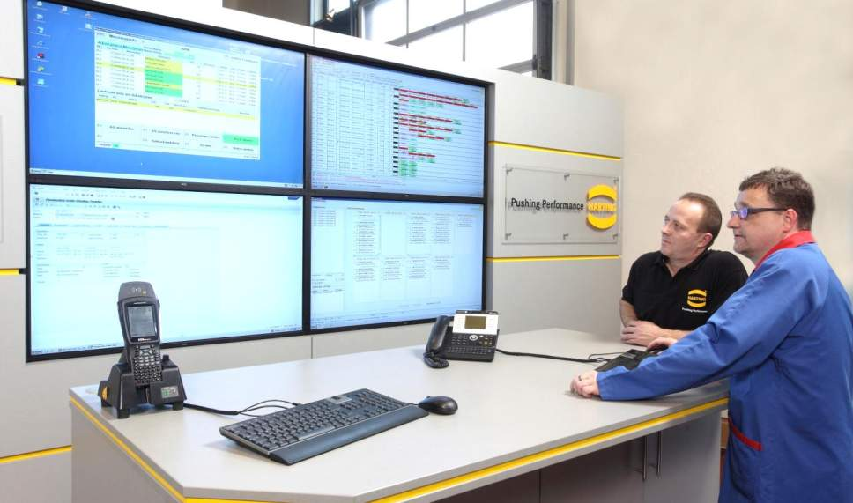
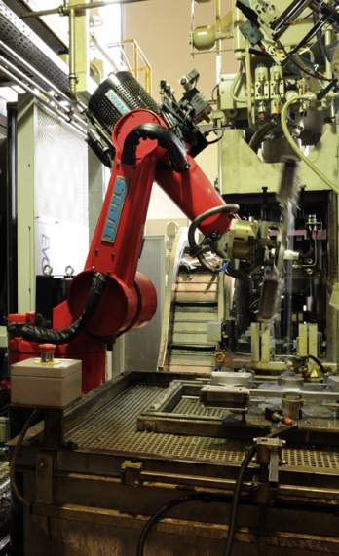
eKanban in pressure molding manufacturing

Slide 24
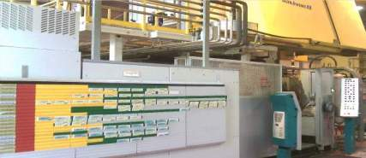
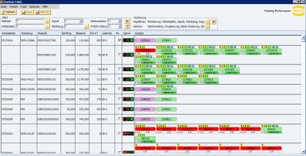
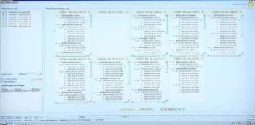
Kanban-/planning-board: old vs. new
Old: Kanban-board
New: system controlled!
ca. 2.500 manual controlled Kanban
manual order start
Kanban system controlled
full ERP integration
Old: planning board
New: system controlled!

Slide 25
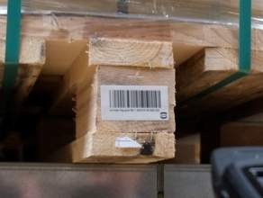
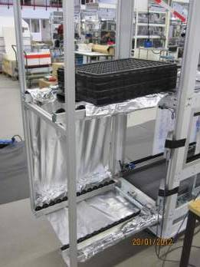
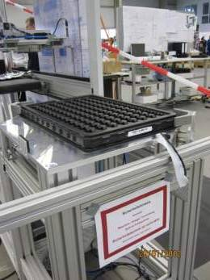
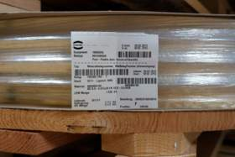
storage integration & plant automation
item identification
storage/location identification
ERP integration
tray identification with short range antenna LR10

Slide 26
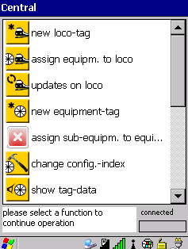
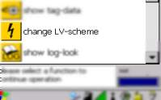
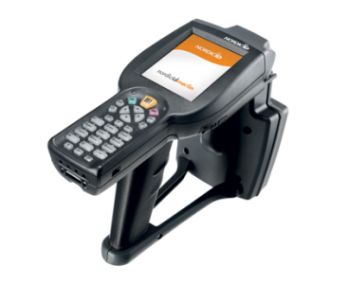
solution for assembly and maintenance
customer: large train manufacturer
application: complete (partial off-line) solution for automated documentation of manufacturing data and MRO process
customer advantage:
high data quality (documentation of product & serial & version)
connection to central QM
time & cost savings
process-dependent user rights
used components:
Locomotive transponder with 8 kByte user memory
equipment transponder with 384 Byte user memory
Nordic ID handheld

Slide 27
Expertise in solutions
services cover the entire process chain within the company from idea to the successful implementation of the solution as well as support of the supplied components.
Project management Control and managment of Auto-ID projects | Training Provision of user training
Business process consulting at all levels From object identification to processing in the backend system | Documentation Generation of project documenation
Concept, specification and pilot applications concept development, preparation of a specification and set-up of a pilot project | Testing and support for going live Execution and support of the test phase and going-live
Installation of the Auto-ID hardware Professional deployment of the hardware-infrastructur | Maintenance and support Software maintenance and further development
Configuration and integration of the components Based on specifications

Slide 28
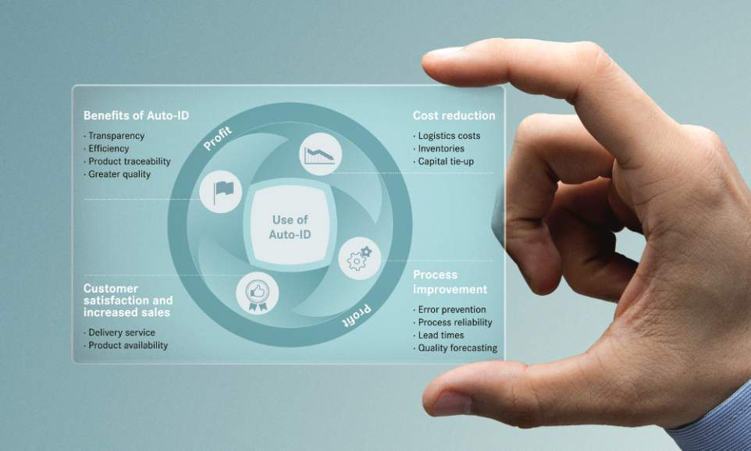
Advantages of Auto-ID

Slide 29
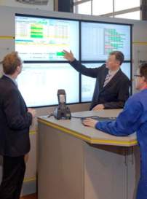
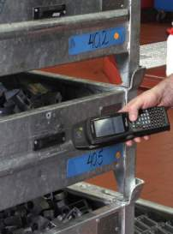
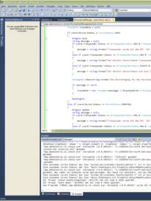
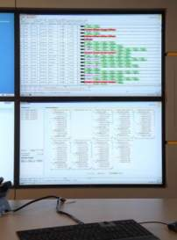
AutoID-solutions from HARTING
+
+
+
Consulting
Hardware
Software
system integration
Integrated Industry: from consulting over hardware to system integration & service
- first hand fulfillment -

